Slide 1

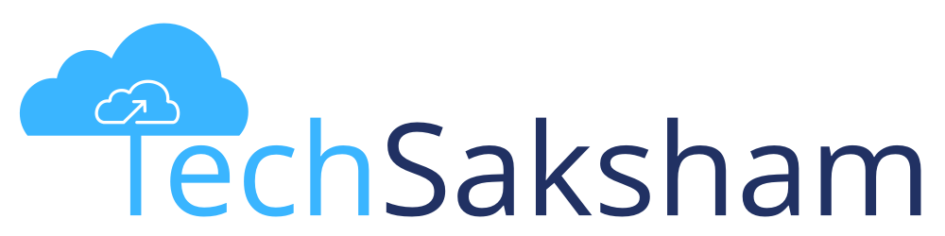



Essentials of Python Programming Language
Notes:
Welcome to this session. This this session is on Essentials of Python Programming Language. Let's discuss the content and the objective of this session then will start with the main content.

Slide 2
Disclaimer
The content is curated from online/offline resources and used for educational purpose only

Slide 3

Learning Objectives
You will learn in this lesson:
Python Programming
How to write first program
Perform basic operations
How to read and write files in Python
Database connectivity
Notes:
Learning Objectives
So here are the learning objective of this session:
will understand the basics of Python programming advantage of Python programming.
We will write the first Python program and understand how to execute that.
Will understand the basic operation like variables, strings functions loops control statement ne available data structures.
We will also learn how we can handles file in Python and Database connectivity.

Slide 4
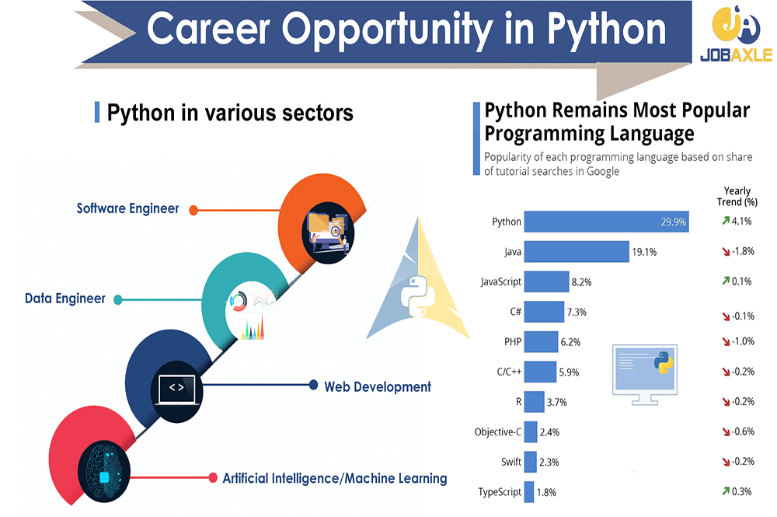
Why do we need to learn Python?
Source:
https://jobaxle.com/blog_detail/career-opportunity-in-python/24
Notes:
Hello friends, let's start this session with a question that why do we need to learn Python?
I hope we know that there are many programming languages in the market right, like Python, Java , JavaScript, and etc. But among these programming languages so we have one programming language that is Python is popular from last 3 to 4 years of time why?
yes friends I am expecting answers from you?
**************
trainer need to ask this question to the students and make them to interact with us. Students will be giving some answers to us depends upon the slide given on the PPT. And we need to provide some examples to the students that where we can use the Python language"
" After getting answers from these students"
********************************************
Yes friends, exactly most of your answers are correct. Now by looking at the right side of the image in PPT, that we can understand, Python remains most popular programming language. The statistics given by the Google that we can see on the slide. Why because,
We can easily learn: Python has a clear and readable syntax, which makes it easier for beginners to understand and learn programming concepts, and
Python can be used for a variety of purposes, such as web development, data analysis, artificial intelligence, machine learning, and more. That is if you learn the basic Python programming language then you can make your carrier into any one of these fields.
The demand for Python developers is consistently high across various industries. Skills in Python can open up a wide range of job opportunities, from software development to data analysis and beyond.
With these words I hope you got a proper motivation to learn about Python programming language. Let's start our journey into the Python.

Slide 5
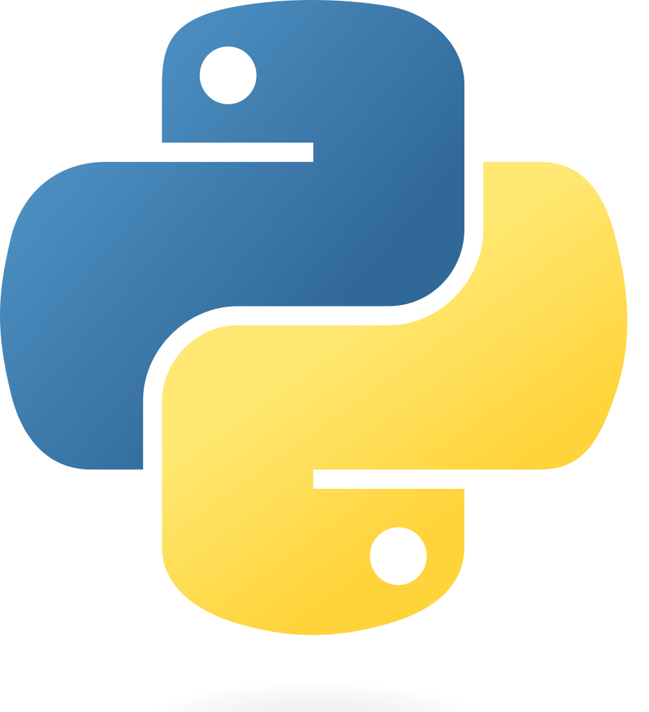
Python
Python uses an interpreter. Not only can we write complete programs, but we can also work with the interpreter in a statement-by-statement mode enabling us to experiment quite easily.
Python is especially good for our purposes in that it does not have a lot of “overhead” before getting started.
It is easy to jump in and experiment with Python in an interactive fashion.
Source:
OIP.AQ5rAzGvicbIAudCjnmlyQHaHa (266×266) (bing.com)
Notes:
One language that is understood and preferred all over the world for development is Python. It's a general-purpose, high-level OOPs based interpreted language, used for dynamic applications, widely across the globe. Python is extremely popular for its versatility and scope of applicability.
Python is a language embraced by a large community of coders for many reasons. Many businesses are advised to choose python as their language for programming. Let’s find out why:
Python is an open-source language. The Python company is one of the largest companies and, still, is free. Using python language doesn’t require a particular subscription or a custom-built platform either.
Python by nature has a very simple syntax. The same logic that needs 7 lines in a C++ language, requires just 3 lines in Python. Having a smaller code requires less space, less time, and is well appreciated by coders, as the rework or correction also takes lesser time.
All Kinds Of Businesses Can Afford It
It is not only suitable for small-medium companies, but leading companies like Google, Spotify, Instagram, and Dropbox, also vouch for python development over other languages. NASA, Electronic Arts, and Disney are among the top non-IT giants who have migrated to the Python environment.

Slide 6
Python Interfaces
IDLE – a cross-platform Python development environment
Anaconda is a Python distribution focused on data driven projects.
PythonWin – a Windows only interface to Python
Python Shell – running 'python' from the Command Line opens this interactive shell
Source:
OIP.AQ5rAzGvicbIAudCjnmlyQHaHa (266×266) (bing.com)
Notes:
Python Interfaces
What does IDLE do in Python?
Just like Python Shell, IDLE can be used to execute a single statement and create, modify, and execute Python scripts. IDLE provides a fully-featured text editor to create Python scripts that include features like syntax highlighting, autocompletion, and smart indent.
In order to run Python Anaconda is the best option for us.
Anaconda is a Python distribution which is very popular and available freely official websites.
PythonWin – is a Windows only interface to Python
Another option is Python shell, Python shell is actually command line interface run Python commands.
For the exercises, we'll use IDLE, but you can try them all and pick a favorite

Slide 7
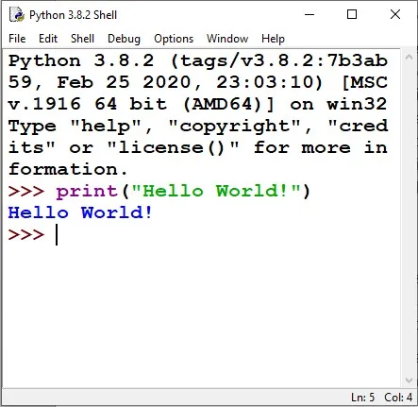
IDLE - Development Environment
IDLE helps you program in Python by:
color-coding your program code
debugging
auto-indent
interactive shell
Notes:
IDLE can be used to execute a single statement just like Python Shell and also to create, modify, and execute Python scripts. IDLE provides a fully-featured text editor to create Python script that includes features like syntax highlighting, autocompletion, and smart indent. It also has a debugger with stepping and breakpoints features.
To start an IDLE interactive shell, search for the IDLE icon in the start menu and double click on it.
This will open IDLE, where you can write and execute the Python scripts, as shown.
7

Slide 8
Print Statement
For output we use statements of the form print <expression>
Semantics
Value of expression is computed
This value is displayed
Several expressions can be printed – separate them by commas
Notes:
The print() function prints the given object to the standard output device (screen) or to the text stream file. Remember the time when you wrote your first program? Yes! I am talking about the “Hello World” program, which is probably the first program that anyone learns in their life. That one line of the program has a print statement that we use daily in our programming without even knowing its intricacies. The purpose of the print() statement is to print the given object to the standard output device or to the text stream file.
Execute the first hello world program using print statement in idle
So this is the syntax in order to display any content in Python program please try this.
8

Slide 9
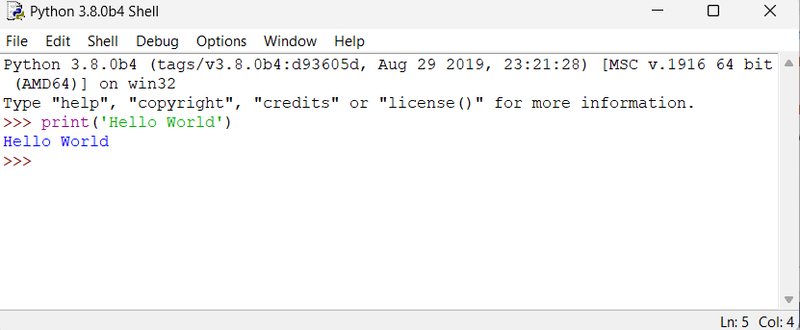
Example of Python
Hello World
print ('hello world')
Prints hello world to standard out
Open IDLE and try it out yourself
Follow along using IDLE
Notes:
So after opening the Python interface either on shall or on any online ide or using Jupyter notebook.
Now in shell write print(“hello word”) command as shown in slide and executed.
You will get the output hello word in front of your screen.
9

Slide 10
Numeric Data Types
int This type is for whole numbers, positive or negative. Examples: 23, -1756
float This type is for numbers with possible fraction parts. Examples: 23.0, -14.561
Notes:
Numeric Data Types
int This type is for whole numbers, positive or negative. Examples: 23, -1756
float This type is for numbers with possible fraction parts. Examples: 23.0, -14.561

Slide 11
More than just printing
Python is an object oriented language
Practically everything can be treated as an object
“hello world” is a string
Strings, as objects, have methods that return the result of a function on the string​
Notes:
Python is an objected oriented programming language. Everything in python is an object. Using python we can create classes and objects, for example, that functions are first-class objects. Functions, classes, strings, and even types are objects in Python: like any object, they have a type, they can be passed as function arguments, and they may have methods and properties.
So in previous example, we printed “hello world” is also become an object of string class in python.
We will understand more on this in upcoming slides.
11

Slide 12

Lab 33: Installation of Python and Hello World Program in Python
Notes:
*******************Trainer will demonstrate how to install python and then how to write a simple program in python.********************

Slide 13
Data Structures in Python
Lists (mutable sets of strings)
var = [] # create list
var = [‘one’, 2, ‘three’, ‘banana’]
Tuples (immutable sets)
var = (‘one’, 2, ‘three’, ‘banana’)
Dictionaries (associative arrays or ‘hashes’)
var = {} # create dictionary
var = {‘lat’: 40.20547, ‘lon’: -74.76322}
var[‘lat’] = 40.2054
Each has its own set of methods
Source:
OIP.AQ5rAzGvicbIAudCjnmlyQHaHa (266×266) (bing.com)
Notes:
Common data structures in python are list, tuple and dictionary
With the help of square bracket we can define list in Python while tuple variable defined by parenthesis.
In order to define dictionary type object curly braces used in Python.

Slide 14
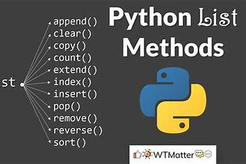
Lists
Think of a list as a stack of cards, on which your information is written
The information stays in the order you place it in until you modify that order
Methods return a string or subset of the list or modify the list to add or remove components
Written as var[index], index refers to order within set (think card number, starting at 0)
You can step through lists as part of a loop
Source:
OIP.puQxxCnV_sa5ageMV--A-wHaEj (351×234) (bing.com)
Notes:
Lists in Python are implemented as dynamic mutable arrays which hold an ordered collection of items.
Lists are useful when we want to store a collection of different data types and subsequently add, remove, or perform operations on each element of the list (by looping through them).

Slide 15
Lists Methods
Adding to the List
var[n] = object #replaces nth value with object
var.append(object) #adds object to the end of the list
Removing from the List
var[n] = [] #empties contents of card, but preserves order
var.remove(n) #removes card at n
var.pop(n) #removes n and returns its value
Notes:
Implement this program in Python notebook for better understanding of list

Slide 16
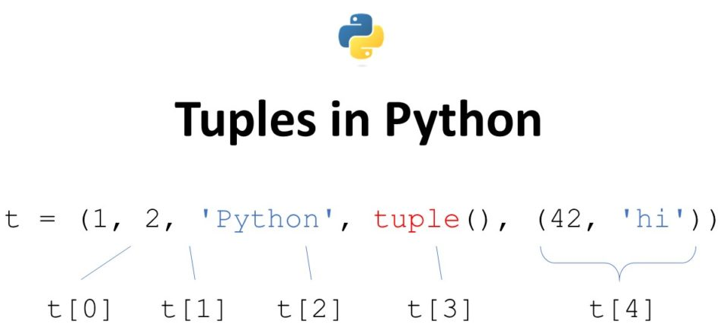
Tuples
Like a list, tuples are iterable arrays of objects
Tuples are immutable - once created, unchangeable
To add or remove items, you must redeclare
Example uses of tuples
County Names
Land Use Codes
Ordered set of functions
Source:
https://blog.finxter.com/the-ultimate-guide-to-python-tuples/
Notes:
Tuples are almost identical to lists, so they contain an ordered collection of elements, except for one property: they are immutable. We would use tuples if we needed a data structure that, once created, cannot be modified anymore. Furthermore, tuples can be used as dictionary keys if all the elements are immutable.
Other than that, tuples have the same properties as lists. To create a tuple, we can either use round brackets (()) or the tuple() constructor. We can easily transform lists into tuples and vice versa (recall that we created the list l4 from a tuple).

Slide 17
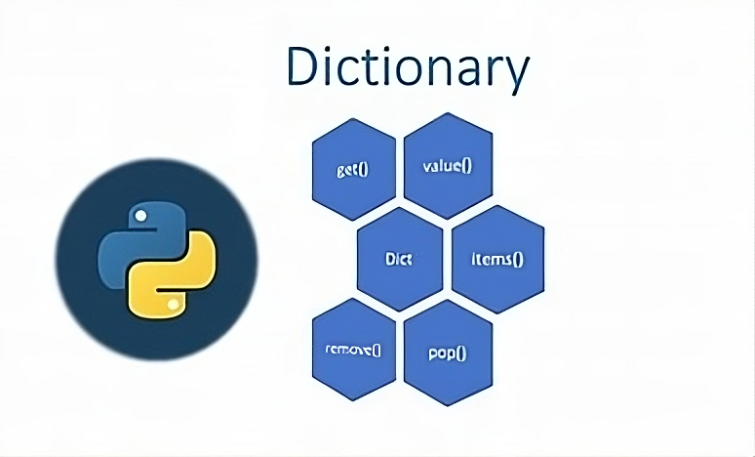
Dictionaries
Dictionaries are sets of key & value pairs
Allows you to identify values by a descriptive name instead of order in a list
Keys are unordered unless explicitly sorted
Keys are unique:
var[‘item’] = “apple”
var[‘item’] = “banana”
print var[‘item’] prints just banana
Source:
OIP.QxN93ABT-n49TvtCYqYmnQHaEK (387×234) (bing.com)
Notes:
Dictionaries in Python are very similar to real-world dictionaries. These are mutable data structures that contain a collection of keys and, associated with them, values. This structure makes them very similar to word-definition dictionaries.

Slide 18
Lab 34: Data Structures in Python
Notes:
Trainer will demonstrate the concepts of Data Structures in Python​ like List, Tuple, Dictionary, Set in the hands-on session.

Slide 19
Indentation and Blocks
Python uses whitespace and indents to denote blocks of code
Lines of code that begin a block end in a colon:
Lines within the code block are indented at the same level
To end a code block, remove the indentation
You'll want blocks of code that run only when certain conditions are met
Notes:
One of the most distinctive features of Python is its use of indentation to mark blocks of code.
Indentation is a very important concept of Python because without properly indenting the Python code, you will end up seeing Indentation Error and the code will not get compiled.
To indicate a block of code in Python, you must indent each line of the block by the same whitespace. The two lines of code in the while loop are both indented four spaces. It is required for indicating what block of code a statement belongs to.

Slide 20
Conditional Branching
if and else
if variable == condition: #do something based on v == c
else:
#do something based on v != c
elif allows for additional branching
if condition:
…............
elif another condition:
….............
else: #none of the above
….............
Notes:
Conditional Branching
We can use the concept of branching to have our code alter its execution sequence depending on the values of variables.
We can use an if statement to evaluate a comparison. We start with the if keyword, followed by our comparison. We end the line with a colon. The body of the if statement is then indented to the right.
If the comparison is True, the code inside the if body is executed. If the comparison evaluates to False, then the code block is skipped and will not be run.
But what if we wanted the code to do something different if the evaluation is false? We can do this using the else statement.

Slide 21
Looping with For
For allows you to loop over a block of code a set number of times
For is great for manipulating lists:
Example:
a = ['cat', 'window', 'defenestrate'] for x in a: print x, len(x)
Results:
cat 3
window 6
defenestrate 12
Notes:
Looping with For
The following loops are available in Python to fulfil the looping needs. Python offers 3 choices for running the loops. The basic functionality of all the techniques is the same, although the syntax and the amount of time required for checking the condition differ.
We can run a single statement or set of statements repeatedly using a loop command.
The following sorts of loops are available in the Python programming language.
1. While loop Repeats a statement or group of statements while a given condition is TRUE. It tests the condition before executing the loop body.
2. For loop This type of loop executes a code block multiple times and abbreviates the code that manages the loop variable.
3. Nested loopsWe can iterate a loop inside another loop.

Slide 22
Lab 35: Control Statements in Python
Notes:
Trainer will demonstrate different conditional and loop statements

Slide 23
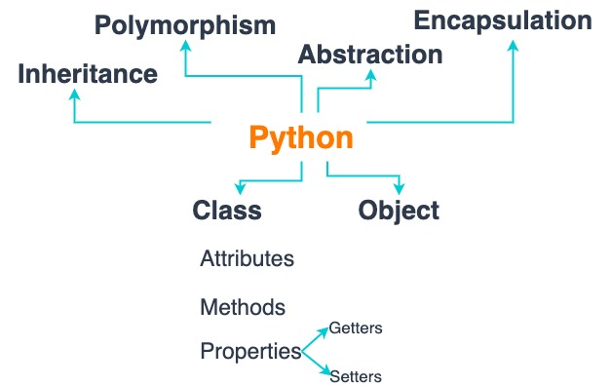
Python OOPs Concepts
Like other general-purpose programming languages, Python is also an object-oriented language since its beginning. It allows us to develop applications using an Object-Oriented approach. In Python, we can easily create and use classes and objects.
Major principles of object-oriented programming system are given below:
Class
Object
Method
Inheritance
Polymorphism
Data Abstraction
Encapsulation
Source:
https://svitla.com/blog/design-object-oriented-code-python
Notes:
Like other general-purpose programming languages, Python is also an object-oriented language since its beginning. It allows us to develop applications using an Object-Oriented approach. In Python, we can easily create and use classes and objects.
Major principles of object-oriented programming system are given below.
Class
Object
Method
Inheritance
Polymorphism
Data Abstraction
Encapsulation

Slide 24
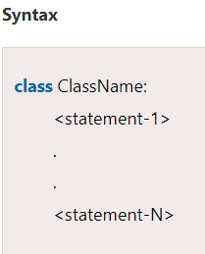
Class
The class can be defined as a collection of objects. It is a logical entity that has some specific attributes and methods. For example: if you have an employee class, then it should contain an attribute and method, i.e. an email id, name, age, salary, etc.
Notes:
Class
The class can be defined as a collection of objects. It is a logical entity that has some specific attributes and methods. For example: if you have an employee class, then it should contain an attribute and method, i.e. an email id, name, age, salary, etc.

Slide 25
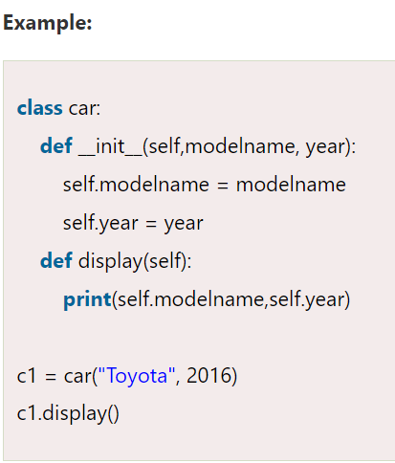
Object
The object is an entity that has state and behavior. It may be any real-world object like the mouse, keyboard, chair, table, pen, etc.
Everything in Python is an object, and almost everything has attributes and methods. All functions have a built-in attribute __doc__, which returns the docstring defined in the function source code.
Notes:
Object
The object is an entity that has state and behavior. It may be any real-world object like the mouse, keyboard, chair, table, pen, etc.
Everything in Python is an object, and almost everything has attributes and methods. All functions have a built-in attribute __doc__, which returns the docstring defined in the function source code.
In the above example, we have created the class named car, and it has two attributes modelname and year. We have created a c1 object to access the class attribute. The c1 object will allocate memory for these values.

Slide 26
Method
The method is a function that is associated with an object. In Python, a method is not unique to class instances. Any object type can have methods.
Notes:
Method
The method is a function that is associated with an object. In Python, a method is not unique to class instances. Any object type can have methods.
Python supports methods as well as functions

Slide 27
Lab 36: OOPS concepts in Python
Notes:
Trainer will explain classes, objects, functions in an IDE

Slide 28
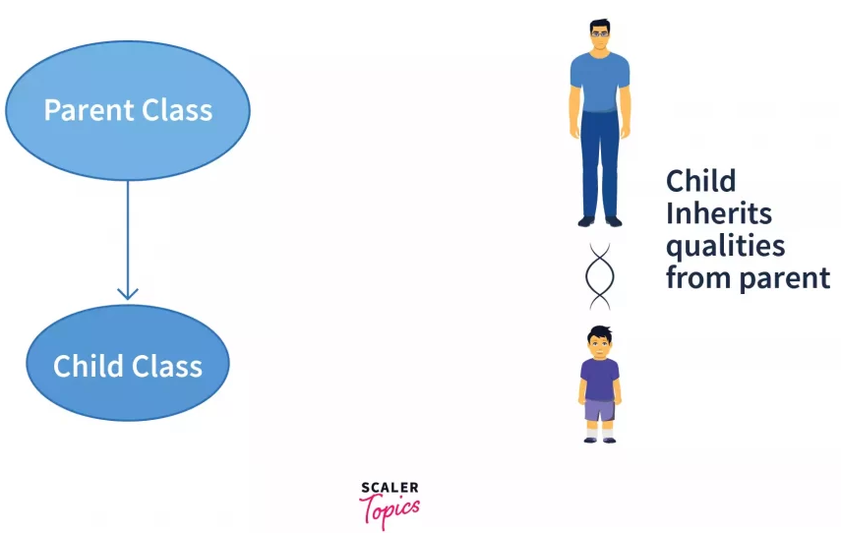
Python Inheritance
Inheritance allows us to define a class that inherits all the methods and properties from another class.
Parent class is the class being inherited from, also called base class.
Child class is the class that inherits from another class, also called derived class.
Source:
https://www.scaler.com/topics/python/inheritance-in-python/
Notes:
Inheritance allows us to define a class that inherits all the methods and properties from another class.
Parent class is the class being inherited from, also called base class.
Child class is the class that inherits from another class, also called derived class.

Slide 29
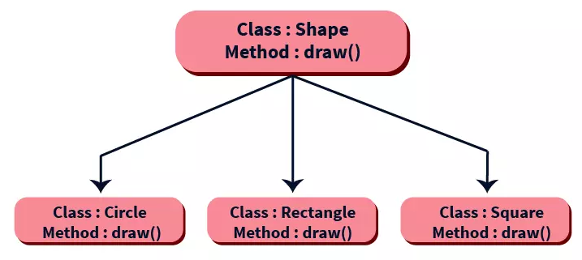
Python Polymorphism
The word "polymorphism" means "many forms", and in programming it refers to methods/functions/operators with the same name that can be executed on many objects or classes.
Source:
https://www.scaler.com/topics/python/polymorphism-in-python/
Notes:
The word "polymorphism" means "many forms", and in programming it refers to methods/functions/operators with the same name that can be executed on many objects or classes.

Slide 30
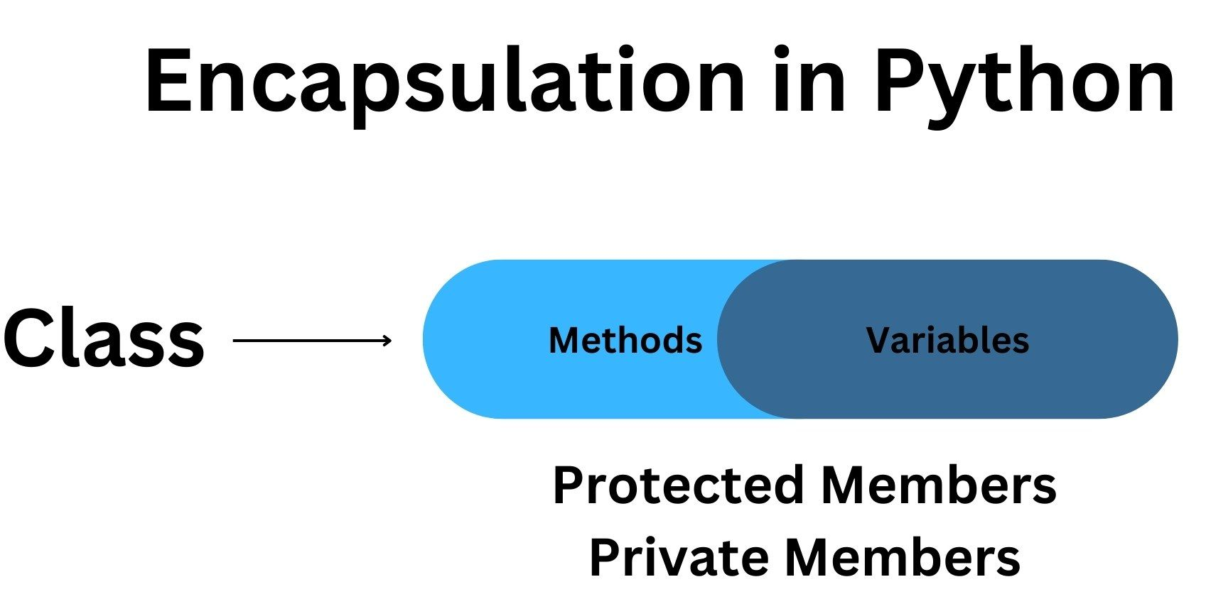
Encapsulation in Python
Encapsulation is a mechanism of wrapping the data (variables) and code acting on the data (methods) together as a single unit. In encapsulation, the variables of a class will be hidden from other classes, and can be accessed only through the methods of their current class.
Source:
https://www.boardinfinity.com/blog/understanding-encapsulation-in-python/
Notes:
Encapsulation is a mechanism of wrapping the data (variables) and code acting on the data (methods) together as a single unit. In encapsulation, the variables of a class will be hidden from other classes, and can be accessed only through the methods of their current class.

Slide 31
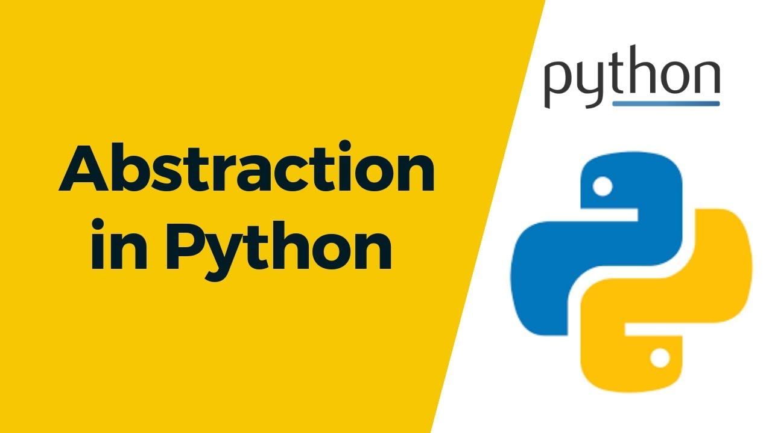
Data Abstraction in Python
Data abstraction and encapsulation both are often used as synonyms. Both are nearly synonyms because data abstraction is achieved through encapsulation.
Abstraction is used to hide internal details and show only functionalities. Abstracting something means to give names to things so that the name captures the core of what a function or a whole program does.
Source:
8N1b4sGzdTgAAAABJRU5ErkJggg== (300×168)
Notes:
Data abstraction and encapsulation both are often used as synonyms. Both are nearly synonyms because data abstraction is achieved through encapsulation.
Abstraction is used to hide internal details and show only functionalities. Abstracting something means to give names to things so that the name captures the core of what a function or a whole program does.

Slide 32
Lab 37: Advanced OOPS concepts in Python
Notes:
Trainer will show how to implement Inheritance, polymorphism, abstraction, encapsulation.

Slide 33
Integration of Database Technologies with Python
Notes:
Integration of Database Technologies with Python
Now let's understand how to connect a python program to database

Slide 34
Python Modules for Database Connection
In Python, we can use the following modules to communicate with MySQL
MySQL Connector Python
PyMySQL
MySQLDB
MySqlClient
OurSQL
Above all interfaces or modules adhere to Python Database API Specification v2.0 (PEP 249) i.e., the syntax, method, and way of accessing the database are the same in all.
Notes:
A database is basically a collection of structured data in such a way that it can easily be retrieved, managed and accessed in various ways. It is very simple to connect Python with the database. Python connects with the database when a connection request is sent to MySQL connector Python, gets accepted from the database and cursor is executed with result data. There are many ways we can connect to MySQL other than MySQL Connector Python, such as PyMySQL, MySQLDB, MySqlClient, and OurSQL

Slide 35
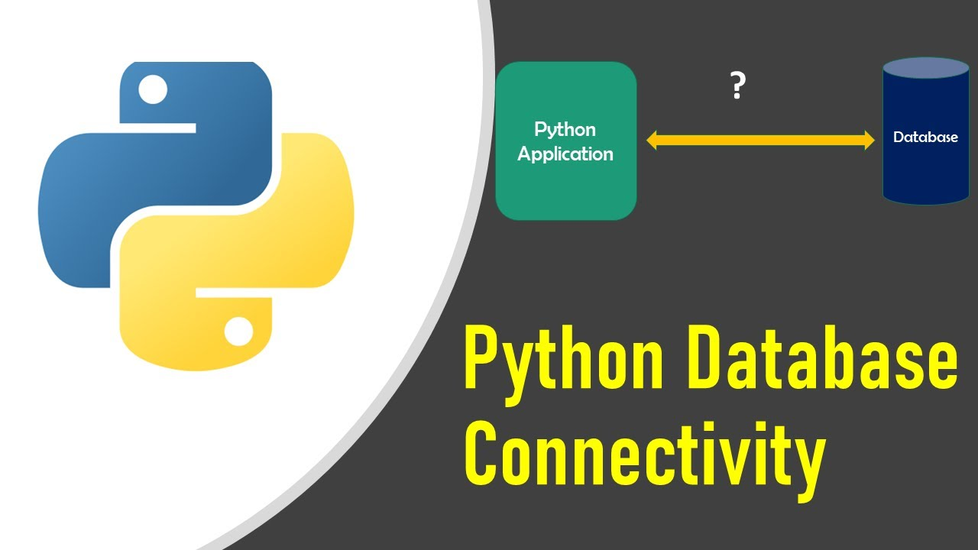
Python with Databases
Python supports relational database systems.
It is very easy to migrate and port database application interfaces (compatible database APIs).
Python also supports Data Definition Language (DDL), Data Manipulation Language (DML) and Data Query Statements.
Source:
maxresdefault.jpg (1280×720) (ytimg.com)
Notes:
Python supports relational database systems. We can connect to relational databases for analysing data using the pandas library as well as another additional library for implementing database connectivity. It is very easy to migrate and port database application interfaces (compatible database APIs). Python also supports Data Definition Language (DDL), Data Manipulation Language (DML) and Data Query Statements. DDL is used to define data structures. The SQL commands that deals with the manipulation of data present in the database belong to DML. DQL statements are used for performing queries on the data within schema objects.

Slide 36
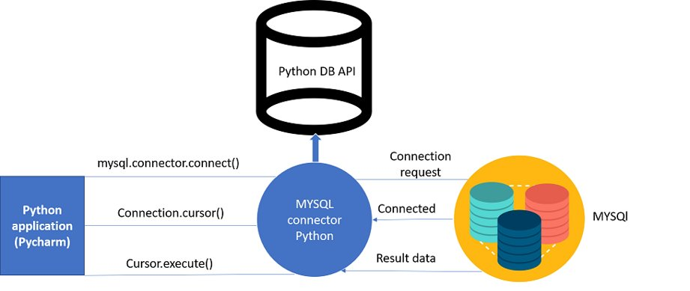
Procedure
Source:
https://yuiltripathee.medium.com/connect-your-database-in-python-code-works-almost-everywhere-21637b311bb4
Notes:
Install Python 3.8 or higher from here.
Install MySQL server from here
Install MySQL connector from here.
Run command import mysql.connector in python editor.
Connect to the database using connect() method.
Create an object for your database.
Execute the SQL query.
Fetch records from the result.
Informing the Database if you make any changes in the table.

Slide 37
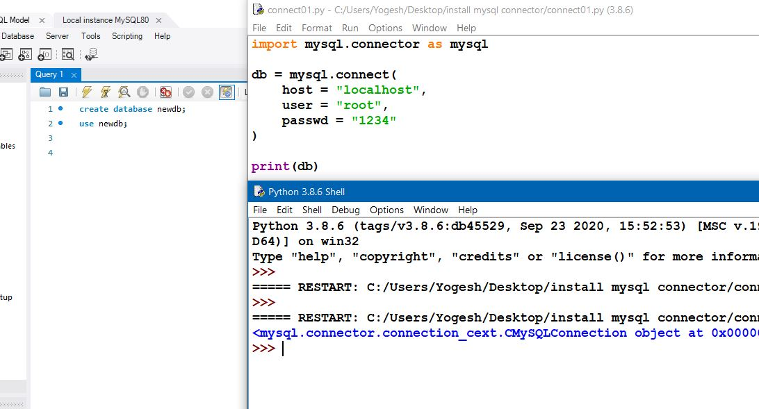
Establishing a Database Connection
connect() method
Takes 4 parameters –
host
user
password
database
Notes:
Python code shows how to connect to an existing database by using connect() method.
Here we takes 4 Parameters:
1. host name : localhost
2. user name : your mysql username (default : "root")
3. password
Now, here 4th parameter is database name,
4. database name
If the database does not exist, database object will be returned.

Slide 38
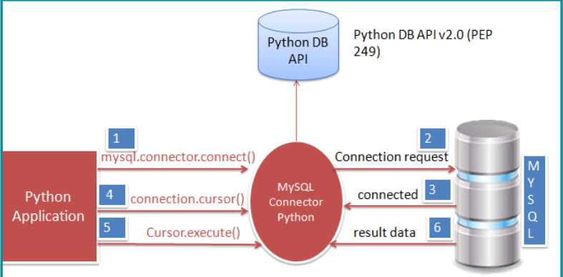
Creating Database Tables in Python
cursor() - used to execute SQL statements
execute() - used to compile SQL statements
fetchall() - fetches all the rows from the last executed statement
Source:
py-db-connection-edureka.png (979×411)
Notes:
We can create a table using python, by first importing the mysql.connector package. Using the mysql.connector.connect() method, a connection object is created, by passing the parameters to it. A cursor object is next created by invoking the cursor() method on the connection object created before. The execute()method is used to compile all the SQL statements. The method fetchall() fetches all or all the remaining rows of a query result set and returns a list of tuples. If no more rows are available, it returns an empty list.

Slide 39
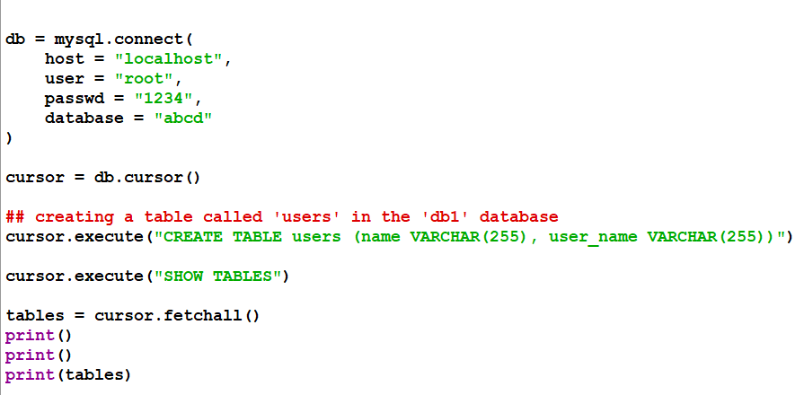
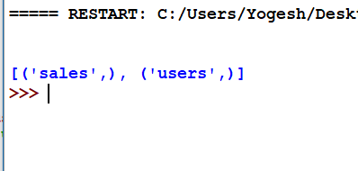
Creating Database Tables in Python
Output -
Notes:
CREATE TABLE is the keyword telling the database system what you want to do. In this case , you want to create a new table. The unique name or identifier for the table follows the CREATE TABLE statement.
1. we have database name "abcd"
2. creating table using CREATE TABLE
3. using "execute" commend to execute the query e

Slide 40
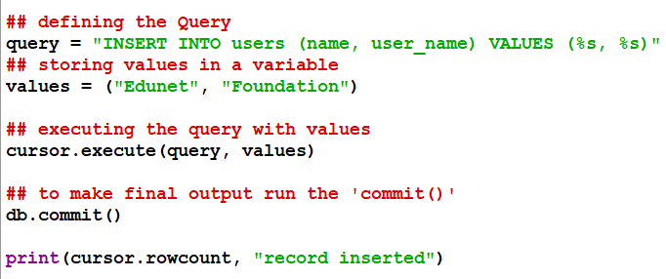
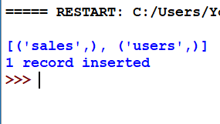
Database INSERT in Python
INSERT INTO table_name (column_names) VALUES (data)
Output -
Notes:
It is possible to write the INSERT INTO statement in two ways:
1. Specify both the column names and the values to be inserted:
INSERT INTO table_name (column1, column2, column3, ...)
VALUES (value1, value2, value3, ...);
2. If you are adding values for all the columns of the table, you do not need to specify the column names in the SQL query. However, make sure the order of the values is in the same order as the columns in the table. Here, the INSERT INTO syntax would be as follows:
INSERT INTO table_name
VALUES (value1, value2, value3, ...);

Slide 41
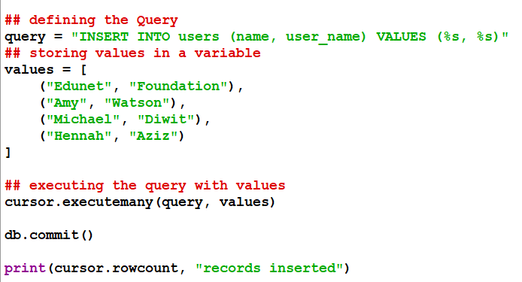
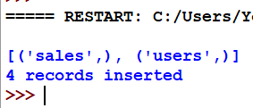
Inserting Multiple rows in Python
Output -
Notes:
This is second way to inserting data,
2. If you are adding values for all the columns of the table, you do not need to specify the column names in the SQL query. However, make sure the order of the values is in the same order as the columns in the table. Here, the INSERT INTO syntax would be as follows:
INSERT INTO table_name
VALUES (value1, value2, value3, ...);
You may not need to specify the column(s) name in the SQL query if you are adding values for all the columns of the table. But make sure the order of the values is in the same order as the columns in the table.

Slide 42
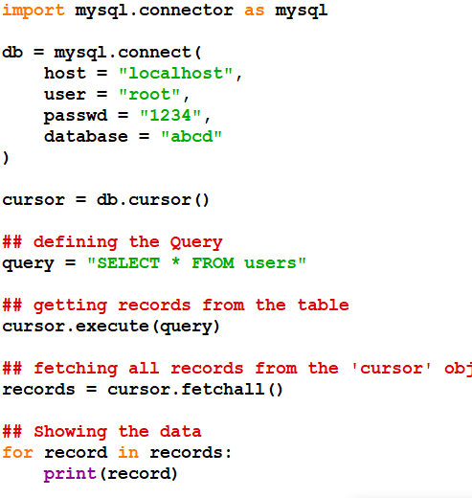
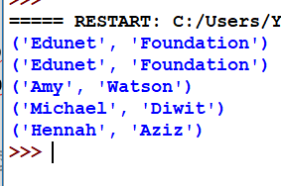
SELECT statement in Python
SELECT column_names FROM table_name
Output -
Notes:
The SELECT statement is used to select data from a database.
The data returned is stored in a result table, called the result-set.
SELECT Syntax
SELECT column1, column2, ...
FROM table_name;
Here, column1, column2, ... are the field names of the table you want to select data from. If you want to select all the fields available in the table, use the following syntax:
SELECT * FROM table_name;

Slide 43
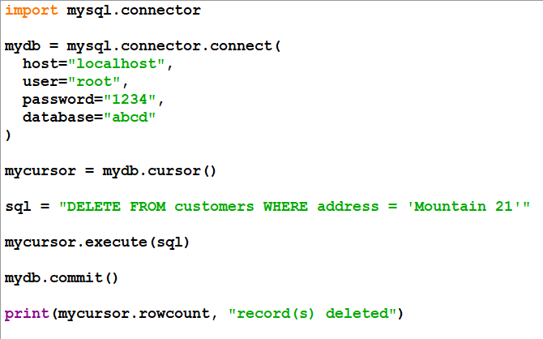
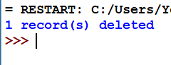
DELETE statement in Python
DELETE FROM table_name WHERE condition
Output -
Notes:
The MySQL DELETE Statement
The aDELETE statement is used to delete existing records in a table.
DELETE Syntax
DELETE FROM table_name WHERE condition;
Note: Be careful when deleting records in a table! Notice the WHERE clause in the DELETE statement.
The WHERE clause specifies which record(s) should be deleted. If you omit the WHERE clause, all records in the table will be deleted!

Slide 44
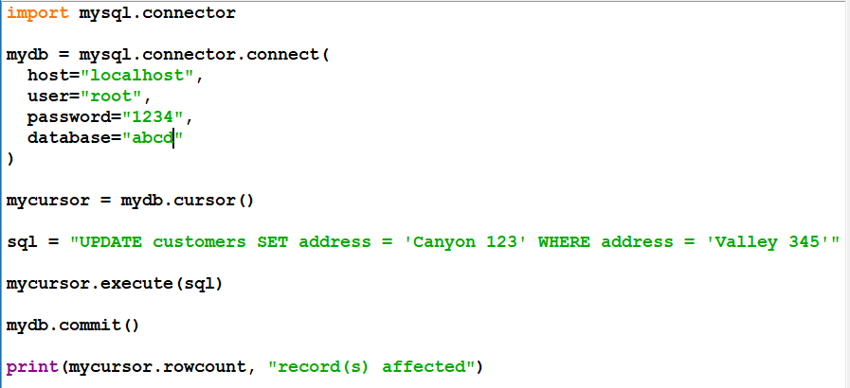
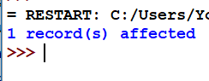
UPDATE Statement in Python
UPDATE table_name SET column_name = new_value WHERE condition
Output -
Notes:
The MySQL UPDATE Statement
The UPDATE statement is used to modify the existing records in a table.
UPDATE Syntax:
UPDATE table_name
SET column1 = value1, column2 = value2, ...
WHERE condition;
Note: Be careful when updating records in a table! Notice the WHERE clause in the UPDATE statement.
The WHERE clause specifies which record(s) that should be updated. If you omit the WHERE clause, all records in the table will be updated!

Slide 45
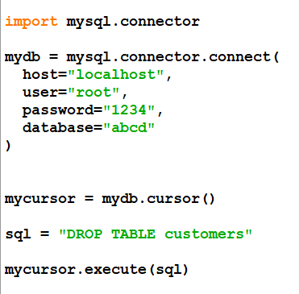
DROP Statement in Python
Output -
© Edunet Foundation. All rights reserved.
Notes:
The MySQL DROP TABLE Statement
The DROP TABLE statement is used to drop an existing table in a database.
Syntax
DROP TABLE table_name;
Note: Be careful before dropping a table. Deleting a table will result in loss of complete information stored in the table!
MySQL TRUNCATE TABLE
The TRUNCATE TABLE statement is used to delete the data inside a table, but not the table itself.
Syntax
TRUNCATE TABLE table_name;

Slide 46
Lab 38: Database Connectivity in Python
Notes:
Trainer will show database connectivity with python. CRUD operations should be demonstrated.

Slide 47
Introduction to Python Popular Frameworks
Python is one of the most popular and effective programming languages that contain vast libraries and frameworks for almost every technical domain. Python frameworks automate the implementation of several tasks and give developers a structure for application development. Each framework comes with its own collection of modules or packages that significantly reduce development time.
Notes:
Python is one of the most popular and effective programming languages that contain vast libraries and frameworks for almost every technical domain. Python frameworks automate the implementation of several tasks and give developers a structure for application development. Each framework comes with its own collection of modules or packages that significantly reduce development time.
47

Slide 48
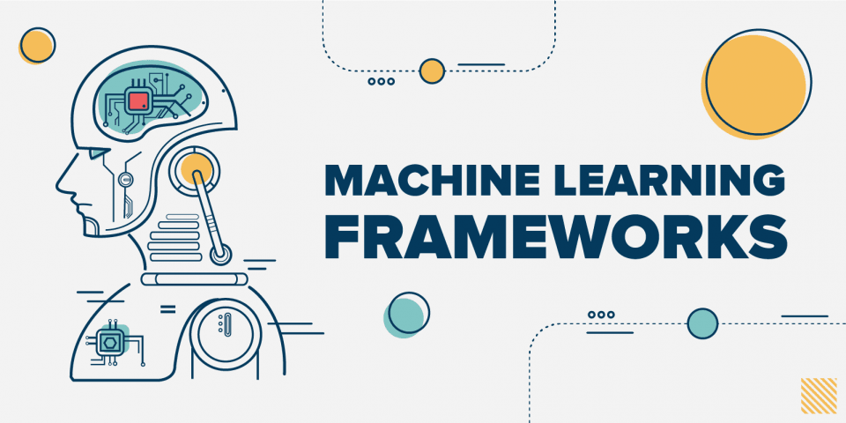
Python Frameworks for ML and DL
TensorFlow
Keras
PyTorch
Scikit-Learn
Source:
1588602415d0xfhuoXiu.png (960×480) (hackr.io)
Notes:
TensorFlow
The most popular library for Machine Learning, TensorFlow is the best Python application development tool for advanced solutions. It simplifies building Machine Learning models for beginners and professionals. It has built-in modules for visualization, inspection and model serialization.
Keras
One of the fastest-growing Deep Learning framework packages, Keras enables using high-level network AP, along with a clean user interface. It enables engineers to combine standalone modules with low restrictions.
Keras is highly used in building neural layers, solutions with activation and cost functions, batch normalization, and more. It works on top of TensorFlow, which extends its functionality for ML-based projects.
PyTorch
The primary aim of PyTorch is to speed up the entire process of Python app development for Machine Learning solutions. It has a C++ frontend along with the Python interface. PyTorch enables quick production deployment, providing companies with rapid solutions.
Scikit-Learn
One of the top Python libraries for Machine Learning, Scikit Learn integrates swiftly with NumPy and Pandas. It enables building Machine Learning models for classification, regression, clustering, dimensionality reduction, and other types of algorithms.
48

Slide 49
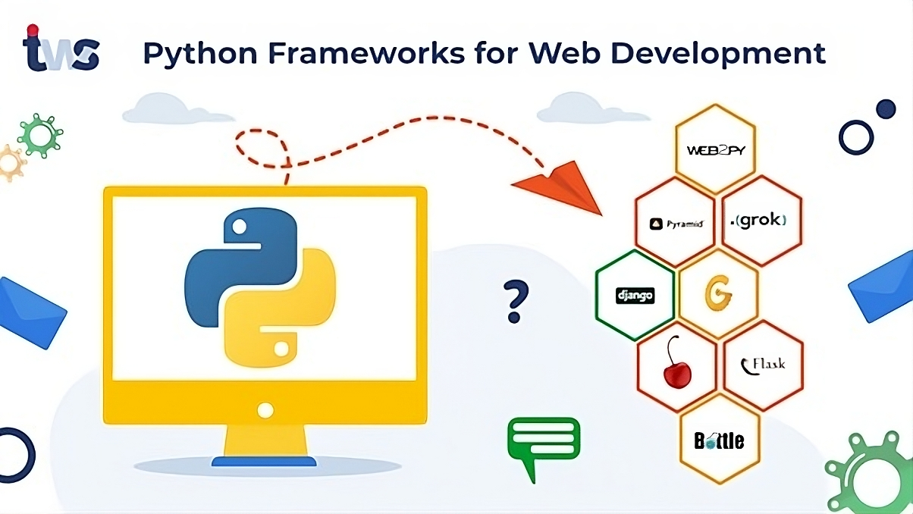
Python Frameworks Web Development
Python frameworks available in the market for web development. Depending on the functionality and key features they provide to the user, below are the frameworks available for web development.
Django
Flask
Source:
Python-Frameworks-for-Web-Development.jpg (1068×601) (tekkiwebsolutions.com)
Notes:
Python frameworks available in the market for web development. Depending on the functionality and key features they provide to the user, below are the frameworks available for web development.
Django
Django is a popular open-source full-stack Python framework that includes all the necessary Python features by default. It follows the DRY principle - Don’t Repeat Yourself. Django uses an ORM or object-relational mapper to map objects to database tables. This helps you use the object-oriented paradigm to manipulate data from a database. The main databases that Django works on are Oracle, MySQL, PostgreSQL, and SQLite. It can also work on other databases using third-party drivers.
Flask
Flask is a micro-framework for Python. It is lightweight and easily adaptable to suit a developer’s needs. The Flask framework comes under the BSD license and requires the Werzeug WSGI toolkit and Jinja2 templates.
49

Slide 50
Summary
Python is a high-level, versatile programming language known for its readability and simplicity.
Python supports both procedural and object-oriented programming paradigms and has a rich ecosystem of libraries.
Python's indentation-based syntax enforces code readability.
Python is widely used for web development, data analysis, artificial intelligence, and automation due to its extensive standard library and active community support.
Notes:
Python frameworks available in the market for web development. Depending on the functionality and key features they provide to the user, below are the frameworks available for web development.
Django
Django is a popular open-source full-stack Python framework that includes all the necessary Python features by default. It follows the DRY principle - Don’t Repeat Yourself. Django uses an ORM or object-relational mapper to map objects to database tables. This helps you use the object-oriented paradigm to manipulate data from a database. The main databases that Django works on are Oracle, MySQL, PostgreSQL, and SQLite. It can also work on other databases using third-party drivers.
Flask
Flask is a micro-framework for Python. It is lightweight and easily adaptable to suit a developer’s needs. The Flask framework comes under the BSD license and requires the Werzeug WSGI toolkit and Jinja2 templates.
50

Slide 51

Quiz
1. What is Python primarily known for?
Speed optimization
Complex syntax
Readable and clean syntax
Low-level memory management
Answer: c
Readable and clean syntax
Notes:
51

Slide 52
Quiz
2. Which of the following is used to define a block of code in Python?
Parentheses ()
Brackets []
Indentation
Semicolons ;
Answer: c
Indentation
Notes:
52

Slide 53
Quiz
3. What does the if statement do in Python?
Iterates through a sequence
Defines a loop
Executes a block of code conditionally
Prints a value
Answer: c
Executes a block of code conditionally
Notes:
53

Slide 54
Quiz
4. Which Python data type is ordered, mutable, and allows duplicate elements?
Set
List
Tuple
Dictionary
Answer: b
List
Notes:
54

Slide 55
References
https://docs.python.org/3/library/
https://www.tutorialspoint.com/numpy
https://towardsdatascience.com/
https://pynative.com/
https://medium.com/javarevisited/top-5-python-frameworks-for-web-development-e034ebe85574
https://www.projectpro.io/article/machine-learning-frameworks/509
https://www.javatpoint.com/python-oops-concepts
https://www.shiksha.com/online-courses/articles/abstraction-in-python/
https://www.boardinfinity.com/blog/understanding-encapsulation-in-python/

Slide 56
Thank you!
Notes:
56

